Slide 1
Market Basket Analysis & Product Bundling Recommendations
Increasing Average Order Value in E-commerce
By Olawale Arowojolu

Slide 2
Business Problem
Why We Need This Analysis
Profit margin only 3%
Cannot lower prices to compete
Need to make each customer buy MORE items
What should we suggest next to increase order value?

Slide 3
Simple Data Preparation
Used public Online Retail dataset
Real customer purchases (UK store)
Steps in Excel:
Removed returns & cancellations
Kept only UK orders
Selected top 50 popular products
Made simple table: 1 = bought, 0 = not bought

Slide 4
How I Found the Patterns
Loaded clean table into Weka
Used FP-Growth tool and Aprori model
Settings:
Look for patterns in at least 2% of orders
Found 124 strong "buy together" rules

Slide 5
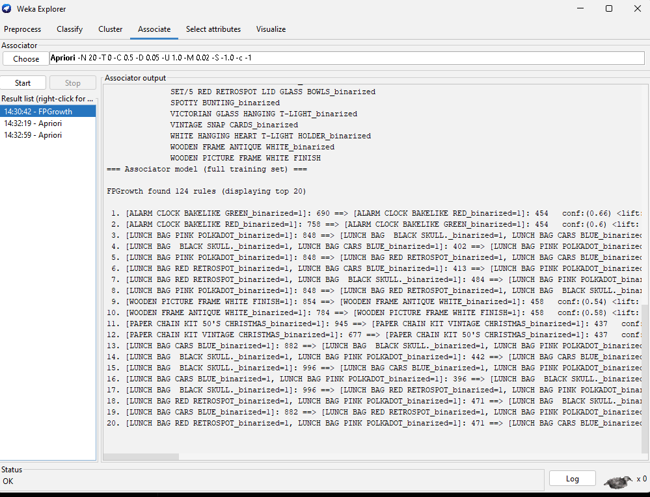
WEKA RESULT FOR APRIORI

Slide 6
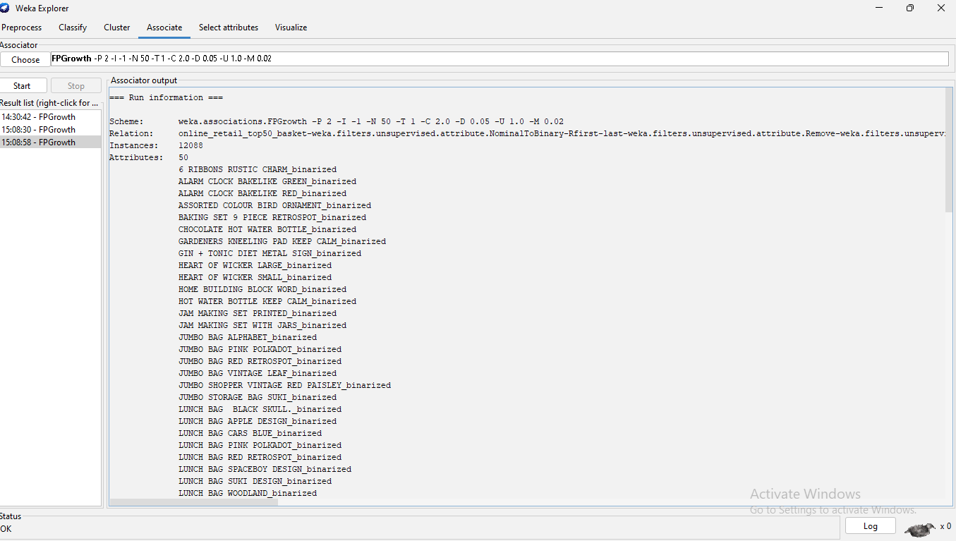
WEKA OUTPUT – FP- Growth model

Slide 7
Top Discoveries
Green Alarm Clock → Red Alarm Clock → 66% of people who
buy green also buy red
Lunch Bag Pink Polkadot + Black Skull → often add Cars
Blue & Red Retrospot → Lift up to 8.9× (very strong!)
White Picture Frame → Antique White Frame → 54–58%
buy both
Christmas Paper Chain 50's → Vintage Christmas Chain

Slide 8
Real Meaning
66% who buy green clock also buy red clock
(only 6% buy red normally)
62% who buy Black Skull + Cars Blue lunch bags
also buy Pink Polkadot (only 3–4% normally)
These pairs are 8–10 times more likely than random

Slide 9
Ready-to-Sell Bundles
4 bundles (big boxes or cards):
Clock Color Pair Green + Red Alarm Clock Offer: 12–15% off
Lunch Bag Mix Set Red Retrospot + Cars Blue + Black Skull + Pink Polkadot Offer: 15% off 4 pieces
White Frame Set Antique White + White Finish Frame Offer: 10–12% off
Christmas Chain Pair 50's + Vintage Paper Chain Offer: 10% off

Slide 10
How Much Can We Gain?
Clock pair: up to +20–40% more sales in clocks
Lunch bag set: up to +25–50% more lunch bags sold
Overall:
10–25% higher average order value in these categories

